Slide 1

Practical Data Engineering with Spark
John Miner Data Architect
john.miner@insight.com

Slide 2
Purpose
Many companies are moving their work loads from on-premise operational data stores to in-cloud data lakes. The spark processing platform is a key player in this transition.
As a developer, how can you leverage your existing SQL skills to take advantage of this growing segment of work?
Today, we are going introduce you to concepts and code that will help you during this transition.

Slide 3



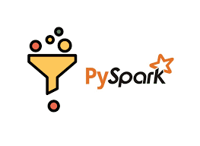
Topics
Spark Eco System
Storage Management
Data engineering
Tables instead of files

Slide 4
Spark Eco System
Various components
Cluster management
Organize code with notebooks
Scheduling actions with jobs

Slide 5
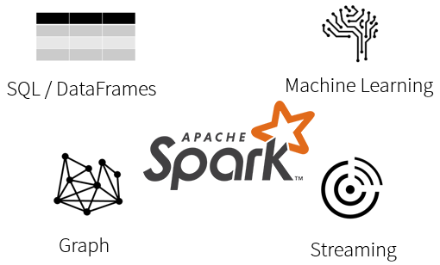
What is Spark?
Spark is a unified processing engine that can analyze big data using SQL, machine learning, graph processing or real-time stream analysis.

Slide 6
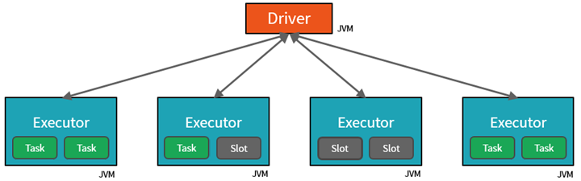
Databricks Cluster
By creating Tasks, the Driver can assign units of work to Slots for parallel execution.
The Driver must also decide how to partition the data so that it can be distributed for parallel processing.

Slide 7
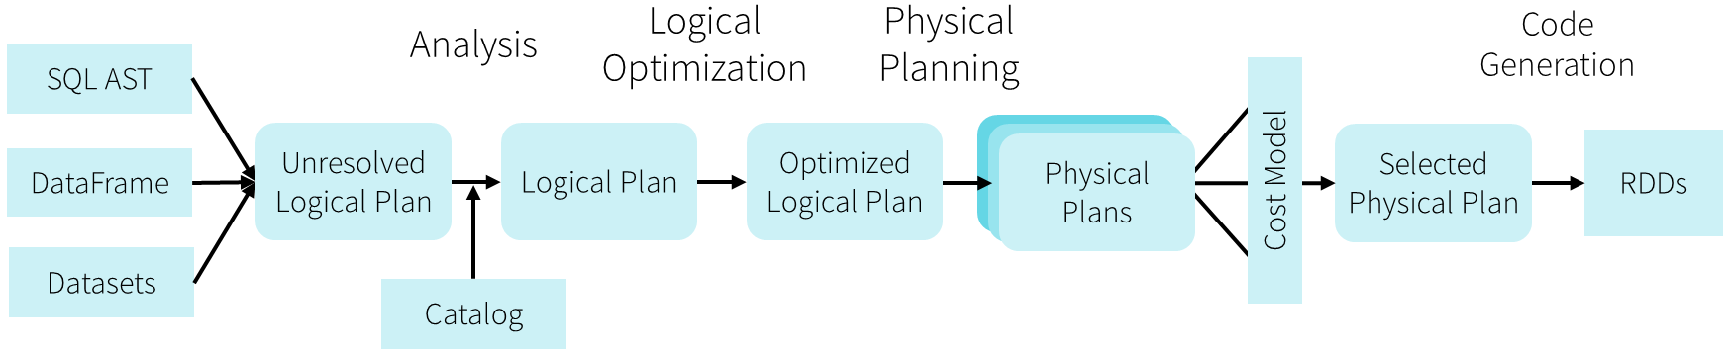
Databricks Optimizer
The Catalyst Optimizer converts the notebook code into an execution model that uses Resilient Distributed Datasets for in memory processing. The resulting code is Java Byte code that can execute on the cluster.
The optimizer is one key difference between open-source Spark and Databricks environment.

Slide 8
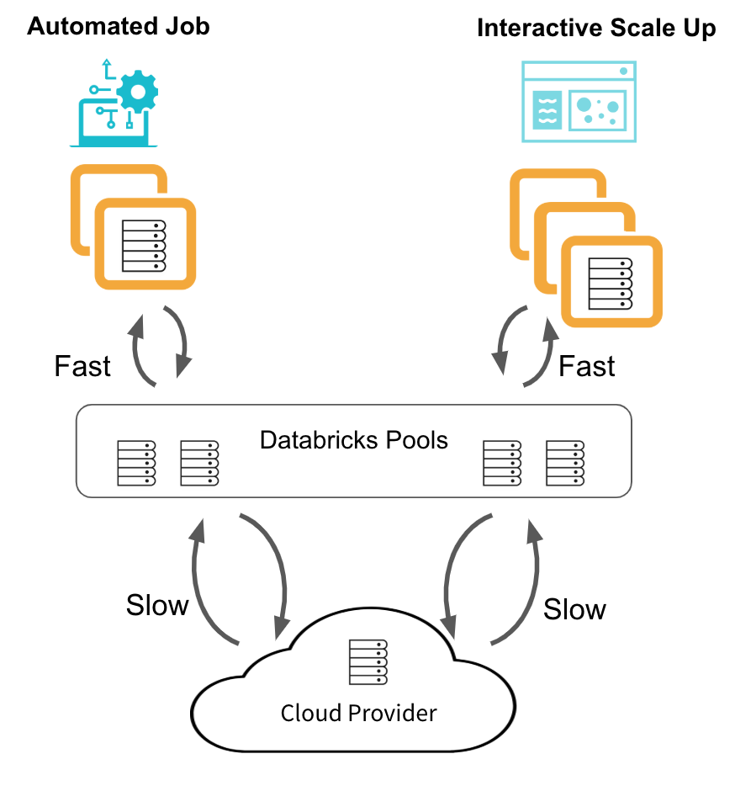
Interactive vs Job + Pool vs Cluster
Databricks allows the developer to schedule a data engineering job (notebook) to run at a given time.
Users execute ad-hoc notebooks to perform one time or repeated analytics on files.
Both automated and interactive jobs require a cluster to run on. The start up time of the cluster is sometimes the most time-consuming part of the process.
Pools allows the system designer to keep a warm cluster around for a specified time after startup (TTL). This means that chance of re-using the virtual hardware reduces the total processing time.

Slide 9
Storage Management
Manage mounts, folders and files
Read and write files
Read faster with schemas
Explore supported file formats

Slide 10
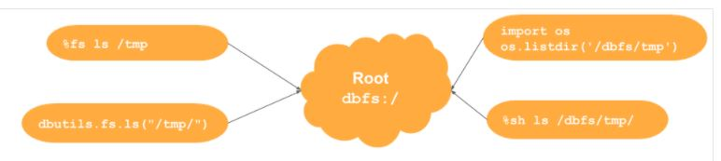
Databricks File System
Out of the box, the Azure Databricks system has a local file system. Remote storage can be mounted or attached to at run time.
There are many ways to work with files and folders.

Slide 11
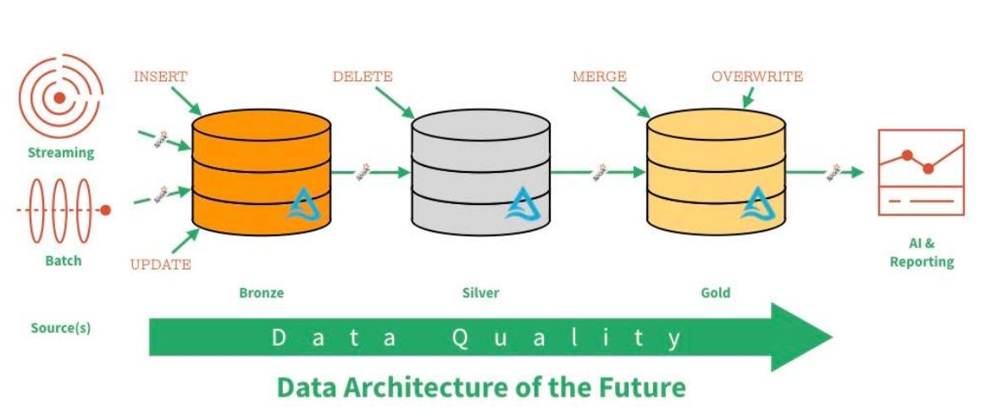
Data Lake – Zones & Data Quality

Slide 12
Manage mounts, folders & files
Suggest using the Databricks library to create, copy, rename and delete both files and folders.
Databricks supports both session level and service level connections to the storage.
Suggest using mounted storage since non spark libraries will work.
[advance topic] - key vault backed secret scope
[example 1 & 2] – manage local & remote storage.

Slide 13
Various File Types
Weakly typed file formats can lead to data quality and ETL pipeline issues. For instance, a delimited file type as Comma Separated Values (CSV) can be easily broken. This file type does not allow for compression.
Strongly typed file formats can lead to better data quality and the least amount of ETL pipeline issues. For instance, an Apache Parquet file format is stored as binary data, contains columns names/types and allows for compression of the data.

Slide 14
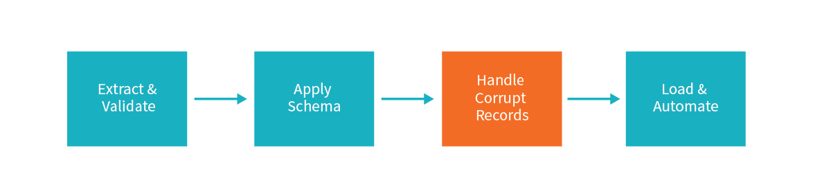
Processing files
Weakly typed files take more time to process if you are inferring the schema. Consider passing a DDL string for faster processing.
Some files have corrupt records, you must determine what to do with them.

Slide 15
PySpark – Read and write files
PySpark is a Python API for Apache Spark to process larger datasets in a distributed cluster.
Spark.Read() – allows the Python program to read one or more files into a dataframe.
Spark.Write() – allows the Python program write the dataframe to given format using one or more files.
[advance topics] – dataframe methods
[example 3] – read + write data sets

Slide 16
Data engineering
Define data load patterns
Expose files as temporary views
Transform files with Spark SQL
Review advance Spark SQL statements

Slide 17
Load Patterns
The full load design pattern involves replacing the target dataset with a completely new version. Use this pattern with small sized data.
An incremental load design pattern involves merging the target dataset with a small dataset the represents changes over a given time period. For instance, a daily update file. This pattern can be used with small to medium sized data.
For the largest datasets, the use of a partitioning allows the full or incremental patterns to work with a subset of the data.

Slide 18
PySpark – Working with SQL
Create and drop statements for databases, tables and views are supported by the hive catalog.
Spark.Sql() – allows the Python program execute dynamic Spark SQL. For select statements, this action returns a data frame.
The magic command (%sql) allows for the static execution of commands.
df.createOrReplaceTempView() converts a data frame to a session level view.
Please refer to documentation.
[advance topics] – spark functions ~ many
[example 4] – data engineering w/sql

Slide 19
Tables instead of files
Provide ACID properties with delta files
Full vs incremental loading
Expose delta files as hive tables

Slide 20
Delta File Format – Uses parquet files +
ACID transactions make sure complete writes are committed.
Schema enforcement allows only clean data inserted into the lake.
Time travel allows for versioning the delta lake table. Thus, we can view data at any given point.
Snapshot isolation allows for multiple readers and writers.
Open-source format that is built for distributed systems such as Spark.

Slide 21
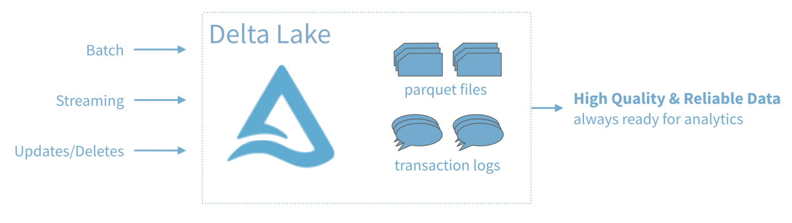
Delta Table = Hive Table based on Delta File

Slide 22
Exploring a dataset with SQL
This section of the presentation is designed to reinforce the fact that SQL skills are applicable to PySpark.
We will be looking at both simple and advance constructs that are available with Spark SQL.
[example 5] – data engineering w/sql

Slide 23
Summary
The modern data platform design for Microsoft Azure allows companies to place a variety of data into a data lake.
Essentially, this data lake follows the spoke and hub design pattern. Source data from producers can be either pushed or pulled into the data lake. Processing can be done on a sub-set of data to allow for investigational queries. Data Science models can be used to predict future events. The final curated data can be available to consumers for analytic reports.
The most important part about deploying objects, creating data lake entries or coding data factory pipelines is the use of naming standards. These standards allow the end user to easily understand the nature and purpose of the item in question.
Both Azure Databricks and Azure Synapse support the Apache Spark architecture. Skills that you learn with Python and Spark will be transferable between the products. The future is bright for those who can adapt.

Slide 24
References
Databricks Documentation
https://docs.databricks.com/index.html
Spark SQL functions
https://spark.apache.org/docs/latest/api/sql/index.html
Spark Data Frames
https://spark.apache.org/docs/latest/api/python/pyspark.sql.html#pyspark.sql.DataFrame
ADB – Local File System
https://www.mssqltips.com/sqlservertip/6700/azure-databricks-local-file-system-management/

Slide 25
Questions / Thank You

